Slide 1


SOCIAL MEDIA SENTIMENT ANALYSIS
PRESENTED BY:
Anisha bakshi(FET/BCE/21/25/057)
Riya SINGH(FET/BCE/21/25/012)
Sonali nanda(FET/bce/21/25/014)

Slide 2

WHAT IS SENTIMENT ANALYSIS IN SOCIAL MEDIA
Sentiment Analysis in social media refers to the process of using Natural Language Processing (NLP), Machine Learning (ML), and Text Analytics to determine the emotional tone behind social media posts, comments, reviews, and tweets. It helps in understanding public opinions, trends, and brand perceptions.
Definition & Purpose: Uses NLP and ML to analyze opinions and trends from social media.
Understanding Sentiment: Identifies whether user sentiment is positive, negative, or neutral.
Business Impact: Helps companies monitor brand perception and make data-driven decisions.
Key Applications: Used in market research, customer feedback, crisis management, and politics.

Slide 3

Plan of Action
Load IMDb Movie Reviews dataset (50,000 reviews)
Pre-process dataset by removing special characters, numbers, etc. from user reviews + convert sentiment labels positive & negative to numbers 1 & 0, respectively
Import GloVe Word Embedding to build Embedding Dictionary + Use this to build Embedding Matrix for our Corpus
Model Training using Deep Learning in Keras for separate: Simple Neural Net, CNN and LSTM Models and analyse model performance and results
Last, perform predictions on real IMDb movie reviews

Slide 4
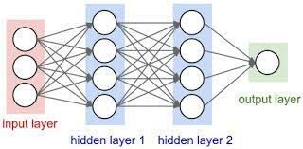
1. Feedforward Neural Network (FNN)
Purpose: FNNs are used as a baseline model for sentiment classification.
How It Works: Text is converted into numerical vectors (TF-IDF, Word2Vec, or BERT embeddings), then passed through fully connected layers.
Use Case: Good for simple sentiment classification (Positive/Negative/Neutral), but lacks sequence awareness.

Slide 5
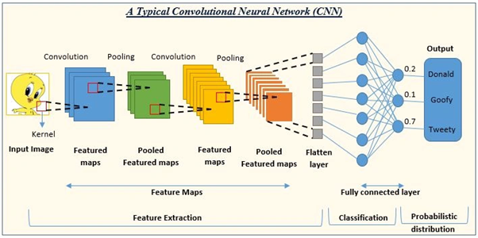
2. Convolutional Neural Network (CNN)
Purpose:
CNNs capture spatial patterns in text data and help extract important word relationships.
How It Works :
Converts text into word embeddings (Word2Vec, GloVe, or FastText).Uses convolutional layers to detect key n-gram patterns.
Pooling layers reduce dimensionality and extract relevant features.
Use Case: CNNs are fast and effective for short text sentiment analysis, such as Twitter posts.

Slide 6
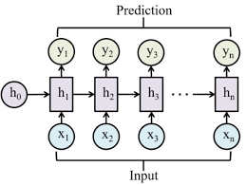
3. Recurrent Neural Network (RNN)
Purpose:
RNNs consider word order and context, making them better for analyzing longer social media posts.
How It Works:
Processes text sequentially, maintaining context between words.
Uses hidden states to retain past information while predicting the next word.
Use Case: Effective for analyzing sentence structure and meaning, but suffers from vanishing gradients in long sequences.

Slide 7
4. Long Short-Term Memory (LSTM)
Purpose:
LSTMs overcome RNN limitations by remembering long-term dependencies, improving accuracy for sentiment analysis.
How It Works:
Uses gates (Forget, Input, Output) to control information flow.Keeps important past context while avoiding vanishing gradient issues.Use Case: Best for analyzing longer social media posts, customer reviews, and opinion trends over time.

Slide 8
ConCLUSION
Social Media Sentiment Analysis is a powerful technique that leverages Machine Learning (ML) and Deep Learning models to understand public opinions, emotions, and trends from social media platforms.
By using FNN, CNN, RNN, and LSTM, we can effectively classify sentiments, extract key patterns, and capture contextual dependencies in text data.
This analysis helps businesses, policymakers, and researchers make data-driven decisions, monitor brand perception, and track social trends.
With advancements in AI and NLP, sentiment analysis continues to evolve, improving accuracy in detecting sarcasm, emotions, and complex linguistic structures.
Future work can focus on enhancing real-time sentiment detection and integrating multimodal data (text, images, and audio) for deeper insights.

Slide 9
THANK YOU

